Slide 1
ELLIPTIC CURVES and APPLICATIONS
Emre Oytun
200104004099

Slide 2
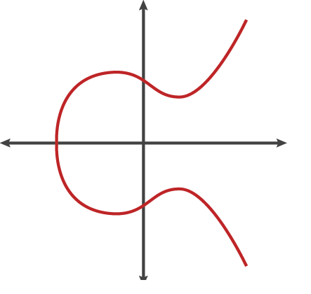
Examples of Elliptic Curves

Slide 3
Introduction
What are Elliptic Curves?
Curve with standard form y² = x³ + ax + b a, b ϵ ℝ
4a³ + 27b² ≠ 0 for non-singularity
Characteristics of Elliptic Curve
Forms an abelian group
Symmetric about the x-axis
Point at Infinity acting as the identity element

Slide 4
Point Addition P+Q
R
Q
P
P+Q

Slide 5
Point at Infinity (0) P + 0 = P
O
P
Q

Slide 6
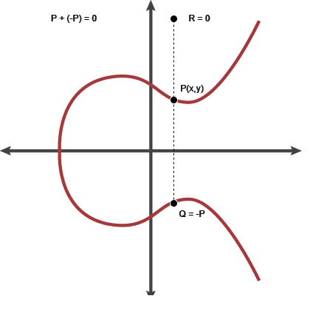
P + (-P) = 0

Slide 7
Doubling of Point P 2P = P + P
Tangent Line to E at P
R
P
2*P

Slide 8
Group Property
E = {(x, y) ∈ K² | y² = x³ + ax + b, 4a³ + 27b² ≠ 0} ∪ {∞}
• (A1): For p1, p2 ∈ E, p1 + p2 = p3 ∈ E
(closure under addition)
• (A2): For p1, p2, p3 ∈ E, p1+(p2+p3) = (p1+p2)+p3
(associativity)
• (A3): O, the point at infinity, is the identity point
(additive identity)
• (A4): For each p ∈ E, there exists p′ ∈ E such that
p+p′ = p′+p = O
(additive inverse)

Slide 9






Addition Formula
Suppose that we want to add the points
P₁ = (x₁,y₁) and P₂ = (x₂,y₂)
on the elliptic curve
E : y² = x³ + Ax + B.
If $x_{1}≠x_{2}$
If $x_{1}=x_{2}$
$$m=\frac{y_{2}−y_{1}}{x_{2}−x_{1}}$$
$$m=\frac{3{x_{1}}^{2}+A}{2y_{1}}$$
$$x_{3}=m^{2}−x_{1}−x_{2}$$
$$y_{3}=m(x_{1}−x_{3})−y_{1}$$

Slide 10
Elliptic Curves over Finite Fields
E : {(x, y) ∈ F_{p}² | y² = x³ + ax + b (mod p), 4a³ + 27b² ≠ 0 (mod p)} ∪ {∞}
Stronger mathematical structure
Forms a group over F_{p}²
Forms a cyclic subgroup

Slide 11
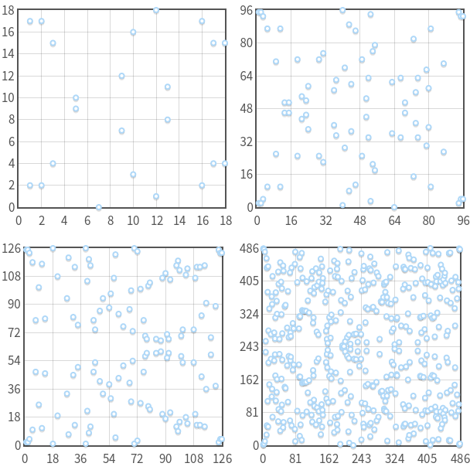
The curve y^2 = x^3 – 7x + 10 (mod p) with p = 19, 97, 127, 487. Note that, for every x, there are at most two points. Also note that, the symmetry about y = p/2.

Slide 12
Elliptic Curves over Finite Fields
Consider y^2 = x^3 + 2x + 3 (mod 5)
X = 0 => y^2 = 3 => no solution (mod 5)
X = 1 => y^2 = 6 => 1 => y = 1,4 (mod 5)
X = 2 => y^2 = 15 = 0 => y = 0 (mod 5)
X = 3 => y^2 = 36 = 1 => y = 1,4 (mod 5)
X = 4 => y^2 = 75 = 0 => y = 0 (mod 5)
Then points on the elliptic curve are
(1,1) (1,4) (2,0) (3,1) (3,4) (4,0)
and the point at infinity: ∞

Slide 13
Cyclic Subgroup
The set of multiples of P forms a cyclic subgroup of the group formed by elliptic curve.
Example:
Elliptic curve: y2 ≡ x3 + 2x + 3 (mod 97)
Generator Point: P = (3, 6). Now, let’s calculate the multiples of P:
0P = 0
1P = (3, 6)
2P = (80, 10)
3P = (80, 87)
4P = (3, 91)
5P = 0
6P = (3, 6)
7P = (80, 10)
8P = (80, 87)
9P = (3, 91)

Slide 14
EC Discrete Logarithm Problem
• Trapdoor function: xP = R (where 1 ≤ x ≤ n).
• Given the curve E, prime number p, and points P and R, finding x is computationally hard.
• Brute-force complexity:
T(n) ∈ O(n) = O(2^{k}) (exponential complexity).
• Best known algorithm (Pollard’s rho or BSGS):
T(n) ∈ O(√n) = O(2^{k/2}).
• For a 256-bit elliptic curve group:
n = 2²⁵⁶, T(n) ∈ O(2¹²⁸) (128-bit security level).

Slide 15
Comparable Key Sizes for Equivalent Security
Symmetric Encryption (Key Size in bits) | RSA and Diffie-Hellman (modulus size in bits) | ECC Key Size in bits
56 | 512 | 112
80 | 1024 | 160
112 | 2048 | 224
128 | 3072 | 256
192 | 7680 | 384
256 | 15360 | 512

Slide 16
Why Elliptic Curve Cryptography?
Shorter Key Length
Lesser Computational Complexity
Low Power Requirement
More Secure

Slide 17
Elliptic Curve Diffie-Hellman Key Exchange (ECDH)
ECDH is a variant of the Diffie-Hellman algorithm for elliptic curves. It is actually a key-agreement protocol.
The problem it solves is the following:
Two parties, Alice and Bob, want to exchange information securely, so that a third party, the Man In the Middle, may intercept them, but can not decode them.

Slide 18
ECDH
Public Knowledge: A group E(F_{p}) and a point P of order n.
BOB ALICE
Choose secret 0 < b < n Choose secret 0 < a < n
Compute K_{Bob} = bP Compute K_{Alice} = aP
Send K_{Bob} to Alice
to Bob Send K_{Alice}
Compute bK_{Alice} Compute aK_{Bob}
Bob and Alice have the shared value bK_{Alice} = abP = aK_{Bob}
The attacker needs to find a from K_{alice} and b from K_{bob},
which takes exponential time as described in ECDLP.

Slide 19
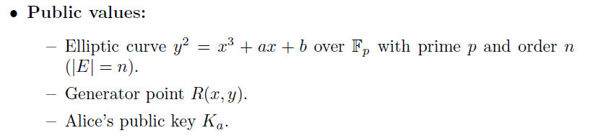
ECDSA
The main problem in cryptosystems is verifying if a message was sent by a specific user. Users need a way to sign messages such that others can verify the signature.
Here’s how it works:

Slide 20
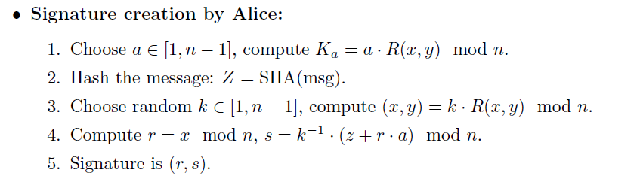
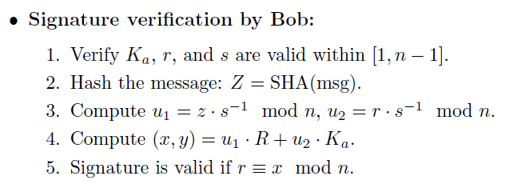
ECDSA

Slide 21
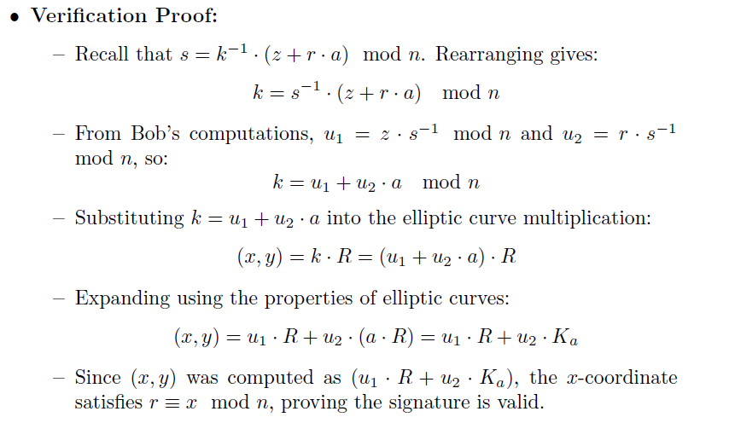
ECDSA

Slide 22
Pros and Cons
Pros
Shorter Key Length
Same level of security as RSA achieved at a much shorter key length
Better Security
Secure because of the ECDLP
Higher security per key-bit than RSA
Higher Performance
Shorter key-length ensures lesser power requirement – suitable in wireless sensor applications and low power devices
More computation per bit but overall lesser computational expense or complexity due to lesser number of key bits

Slide 23
Pros and Cons
Cons
Relatively newer field
Idea prevails that all the aspects of the topic may not have been explored yet – possibly unknown vulnerabilities
Doesn’t have widespread usage
Not perfect
Attacks still exist that can solve ECC (112 bit key length has been publicly broken)
Well known attacks are the Pollard’s Rho attack (complexity O(√n) ), Pohlig’s attack, Baby Step,Giant Step etc

